Slide 1
Forced oscillator
24th August 2020

Slide 2
Review : The driven, undamped harmonic oscillator
The equation of motion for harmonically driven, undamped oscillator may be written as
If a general displacement x is given as , the amplitude A is found to be
depending on φ = 0 or π
and ω₀ = frequency of free oscillation
The phase shift of “0” indicates that the displacement and the driving force are in phase.
The phase shift of “π” indicated that the displacement and the driving force are out of phase by π.
Notes:
Phase φ in the assumption of the displacement indicates that, in general, the displacement and driving force may be out of phase.

Slide 3
(a) the amplitude of a driven oscillator versus ω with no damping.
(b) The phase lag of the displacement relative to the driving force versus ω.
F₀/s
Notes:
As we throw in a little damping at ω close to ω0 the amplitude becomes large but finite. The phase shift smooth out; it is no longer discontinuous, although the shift is still quite abrupt.

Slide 4
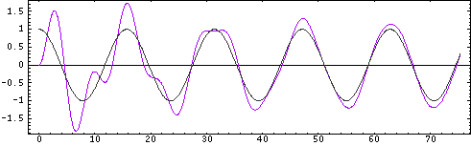
Behavior of the forced oscillator
Consider a mechanical forced oscillator with force F₀cosωt applied to damped oscillator.
The equation of motion is given by
The complete solution for the case is composed of
(1) Transient term and (2) Steady state term
displacement
Applied force
Displacement
Transient + steady state
steady state
time
http://www.acs.psu.edu/drussell/Demos/SHO/mass-force.html
Notes:
In the plot the forcing frequency is f=0.4, so that the first oscillator is being driven below resonance. The grey curve shows the applied force (positive is upwards), and the purple curve shows the displacement of the mass in response to the applied force. After the transient motion decays and the oscillator settles into steady state motion, the displacement is in phase with force. Notice that the frequency of the steady state motion of the mass is the driving (forcing) frequency, not the natural frequency of the mass-spring system. Only in the resonance, the driving force frequency is equal to the natural frequency of the system.

Slide 5
Driven, damped harmonic oscillator
Generally, the applied force may be written as F₀exp(iωt).
Therefore, the equation of motion becomes
Suppose a general solution of the differential equation is
By substituting the general solution into the equation of motion, we obtain the amplitude A as follows
Notes:
Notice the frequency of the solution is equal to the frequency of the driving force!
What we are doing here is to solve the non homogeneous differential equation corresponding to finding the solution of the steady state part.

Slide 6
Description of the steady state term
Therefore, the displacement can be written as
Mechanical impedance is a measure of how much a structure resists motion when subjected to a harmonic force. It relates forces with velocities acting on a mechanical system.
Notes:
Mechanical impedance is a measure of how much a structure resists motion when subjected to a harmonic force. It relates forces with velocities acting on a mechanical system. The mechanical impedance of a point on a structure is the ratio of the force applied at a point to the resulting velocity at that point.
The mechanical impedance is a function of the frequency of the applied force and can vary greatly over frequency. At resonance frequencies, the mechanical impedance will be lower, meaning less force is needed to cause a structure to move at a given velocity.

Slide 7
Complete information of magnitude and phase of the steady state term
The phase difference φ between x
and F due to the reactive part
(ωm – s/m) of Z_{m}.
(2) Extra phase difference gives x lags
F by 90⁰ even φ = 0.
The amplitude of the x is F₀/ω|Z_{m} |
2
1
3
Notes:
This indicates that the phase diff between the driving force and the displacement is due to (1) the reactive part of the mechanical impedance and the intrinsic part pi/2.
Reactive part is the imaginary part of the impedance.
Resistive part is the real part of the impedance.

Slide 8
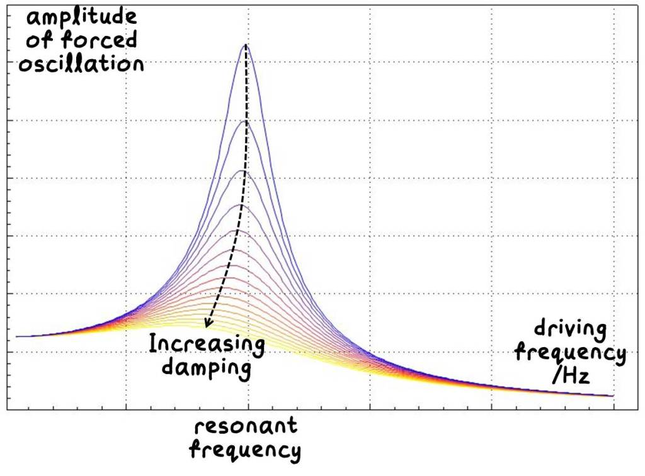
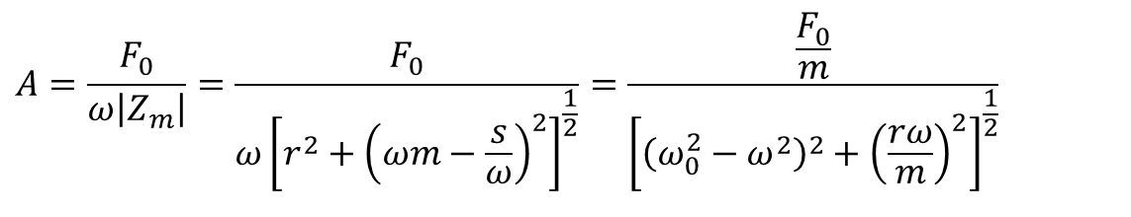
The amplitude of the x
Recall the amplitude from the steady state,
The expression clearly states that the amplitude is a function of the driving frequency, ω.
The amplitude is still finite even though the driving frequency is equal to the frequency of the free oscillation due to the existence of the r.
$$A=\frac{F_{0}}{ω\left|Z_{m}\right|}=\frac{F_{0}}{ω{\left[r^{2}+{\left(ωm−\frac{s}{ω}\right)}^{2}\right]}^{\frac{1}{2}}}=\frac{\frac{F_{0}}{m}}{{\left[{\left(ω_{0}^{2}−ω^{2}\right)}^{2}+{\left(\frac{rω}{m}\right)}^{2}\right]}^{\frac{1}{2}}}$$
What is the resonant frequency of the forced oscillator?
https://xmdemo.wordpress.com/2014/06/22/040-damping-and-resonance-amplitude/
Notes:
The finite amplitude becomes decreasing as the damping coefficient gets larger.
Resonant frequency w^2 = wo^2 – r^2/2m^2
Remember that the frequency of the damping constant w’ ^2= wo^2 – r^2/4m^2
Express the resonant frequency w in terms of damping frequency w’ : w^2 = w’^2 – r^2/4m^2

Slide 9
How to get a resonant frequency of the forced oscillator?
The resonant frequency of the forced oscillator :
The displacement resonance occurs at a frequency slightly less than the free oscillation frequency ω₀. For a small damping constant r or a large m these two resonances occur at the sample frequency ω₀.
Damping coefficient r influences the resonant frequency.

Slide 10
How to represent the forced oscillation resonant frequency in terms of damping frequency?
Recall the damping freely running damping frequency
The resonant frequency of the forced oscillator :
The resonant frequency of the forced oscillator in terms of the damping frequency

Slide 11
A note on the applied force
Instead of using an exponential form, the applied force as written in terms of cosine or since functions leads to the steady state solution as follows
The value of displacement x resulting from F₀cos(ωt) is
The value of displacement x resulting from F₀sin(ωt) is
Both solutions satisfy the information given in the previous page.
Notes:
The phase difference (pi/2) results in the different function forms between the driving force and the displacement.

Slide 12
The value of displacement x resulting from F₀cos(ωt) and F₀sin(ωt)

Slide 13
Mechanical Impedance Z_{m}
Mechanical impedance is a measure of how much a structure resists motion when subjected to a harmonic force. It relates forces with velocities acting on a mechanical system.
Mechanical impedance is a complex quantity given by
The real part, the mechanical resistance, is independent of frequency.
The dissipative forces ( ) are proportional to velocity.
The imaginary part, the mechanical reactance, varies with frequency, becoming zero when equal to the frequency of shm.
https://en.wikipedia.org/wiki/Mechanical_impedance
Notes:
From the summary above the imaginary part becomes zero when the frequency of the applied force is equal to the resonant frequency.
That is wm –s/w = 0 when w = (s/m)^1/2 which is the frequency of shm.
Anti resonant frequency makes the least amplitude of the oscillatory system.

Slide 14
Relation of the velocity and force
Provided that the driving force is given as F₀cos(ωt), the velocity becomes
In case of φ = 0, velocity and force are in phase.
The amplitude of the velocity is F₀/|Z_{m}|, this leads to the definition of the mechanical impedance Z_{m} = F/V

Slide 15
Problem 1
The equation describes the motion of an undamped simple harmonic oscillator driven by a force of frequency ω. -Determine the steady state solution and sketch the behavior of the steady state amplitude versus ω.
-Also find the general solution.

Slide 16
Detailed solution of problem 1
Using the undetermined method, the steady state solution is given as x = Acosωt + Bsinωt
Find dx/dt and d²x/dt² and substitute into
This gives the steady state solution as
The transient solution can be found from
This gives a general form of the solution to be
Finally, the complete solution becomes

Slide 17
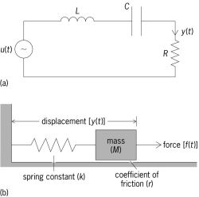
A response of RLC series circuit
The input voltage is equal the sum of the voltage across the inductor, the voltage across the capacitor and the voltage across the resistor.
If V_{a} =V₀exp(iωt), the solution of the above differential equation is given as
Where the electrical impedance Z_{e} is written as
I
V_{a}
To find the solution, we simply compare the electrical system to the mechanical system and substituting m for L, r for R and s for 1/C.
http://encyclopedia2.thefreedictionary.com/forced+oscillation
Notes:
the input voltage is equal to the sum of the voltage across the inductor, the voltage across the resistor, and the voltage across the capacitor, where the voltage across the inductor is the product of its inductance (L) and the rate of change of the current through the inductor; the voltage across the resistor is the product of its resistance (R) and the current passing through it; and the voltage across the capacitor is the integral over time of the current through the capacitor (that is, the charge on the capacitor plates) divided by the capacitance (C).
เมือเปรียบเทียบ phase ระหว่าง กระแสกับ driving voltage พบว่ามี เฟสตรงกัน
Because the de of the mechanical and electrical oscillations are the same. The solution found in the mechanical problem can be directly used here in the electrical problem.
This can be done by substituting m by L, r by R and s by 1/c.

Slide 18
Behavior of velocity v in magnitude versus driving for frequency ω
The magnitude of the velocity amplitude varies with frequency ω because |Z_{m}| is frequency dependent.
The impedance is stiffness controlled : at low frequency, s/ω dominates.
The impedance is mass controlled: at high frequency, ωm dominates.
Zero reactance or minimum impedance : Z_{m} = r and velocity and driving force are in phase. This leads to the velocity resonance F₀/r .
Velocity of forced oscillator versus driving frequency ω.
Notes:
Don’t forget that the driving force is given as Focosωt

Slide 19
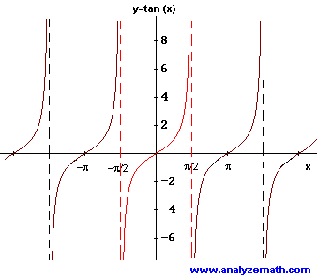
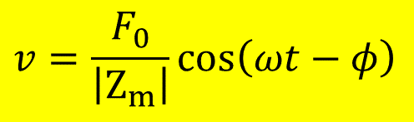
Phase behavior of velocity v versus driving force frequency ω
$$v=\frac{F_{0}}{\left|Z_{m}\right|}\cos\left(ωt−φ\right)$$
According to the relationship between the velocity v and force F,
The applied force is
Generally, v lags F by φ and
Consider 3 situations; φ > 0, φ < 0 and φ = 0.
http://www.analyzemath.com/trigonometry/properties.html
Notes:
Don’t forget that the applied force is given as F = F0coswt.

Slide 20
Variation of phase angle φ versus
driving force frequency ω
ω→∞
tanφ→∞
φ→π/2
Mass controlled
ω = ω₀
tanφ = 0
φ = 0
@ velocity resonance
ω→0
tanφ→-∞
φ→-π/2
Stiffness controlled
At low frequency the velocity leads the force ( φ negative) and at high frequency the velocity lags the force ( φ positive).
Notes:
Don’t forget that the applied force is given as F = F0coswt.

Slide 21
Behavior of displacement in magnitude versus driving force frequency ω
Recall the displacement when the driving force is F₀cos(ωt),
Clearly, the amplitude is given as and
The amplitude function suggests that the graph of x vs ω depends on 3 different ranges of ω.
What would the amplitude be when ω → 0?
What would the amplitude be when ω → ∞ ?
What is the driving frequency at the amplitude resonance? (Next slide!)
Notes:
The displacement here is a result of the driving force F = F0cosωt
What would x be when ω → 0? The amplitude = F/s
What would x be when ω → ∞ ? The amplitude = F/mw^2 → 0

Slide 22
The amplitude resonance of the displacement
The displacement resonance occurs when the denominator ωZ_{m} is a minimum.
This takes place when
The condition gives the driving frequency ω which gives the displacement resonance.
Therefore,
Thus, the displacement resonance occurs at a frequency slightly less than ω₀, the frequency of velocity resonance.
Express the driving resonance frequency in terms of damping frequency?
Already done!
Notes:
Note that if r is very small, the driving frequencies that gives displacement and velocity resonances are the same.
Express the driving resonance frequency in terms of damping frequency?
W^2 = w’^2 –r^2/4m^2

Slide 23

Variation of the displacement of a forced oscillator vs driving force frequency ω
The maximum displacement at resonance amplitude is given as
Due to (Prove this!)
Therefore,
The amplitude at resonance is kept low by increasing r.
$$ω_{r}\left|Z_{m}\right|=ω^{′}r$$
Damping frequency
Notes:
By varying r to be either larger or lower, the amplitude resonance can be exploited.
Keeping the resonance amplitude low is the principle of vibration insulation.
A negligible value of r produces a large amplification at resonance : this is the basis of high selectivity in a tuned radio circuit.
This slide just shows how the maximum displacement of the force oscillator varies with the damping constant.s

Slide 24
Prove
Consider the amplitude of displacement :
The maximum displacement at resonance amplitude is given as

Slide 25
Phase behavior of displacement versus driving force frequency ω
Recall the displacement and the driving force
Since the displacement x lags velocity v by ..……………
Consider when ω → 0, the above condition suggests that x lags/leads/is in phase with F.
Consider when ω → ∞, x lags/leads/is in phase with F.
Consider when ω = ω₀, x lags/leads/is in phase with F.
Notes:
Note: x lags F by Pi at high frequency
X lags by Pi/2 at frequency of free oscillation w0

Slide 26
Variation of total phase angle between displacement and driving force vs driving frequency ω
This can be easily explained when considered each condition firstly with the phase difference between v and F and then x and F provided that x and v is always out of phase by $/2.$

Slide 27
Significance of the two components of the displacement curve (1)
From the displacement
This expression may be rewritten as
Due to and
The displacement is then composed of two terms: resistive fraction and reactive fraction,
Resistive term
Reactive term

Slide 28
Significance of the two components of the displacement curve (2)
The amplitude of the reactive fraction may be written as
The amplitude of the resistive fraction may be written as
Reactive fraction
Resistive fraction

Slide 29
Significance of the two components of the displacement curve (3)
This is clear that the reactive fraction becomes zero and resistive fraction is near its maximum at ω = ω₀.
However, they combine to give a maximum at ω, the resonant frequency for amplitude displacement, where

Slide 30
TRY Problem 3.10
Notes:
Polarizability is the ability to form instantaneous dipoles. It is a property of matter. Polarizabilities determine the dynamical response of a bound system to external fields, and provide insight into a molecule's internal structure.^{[1]} In a solid, polarizability is defined as dipole moment per unit volume of the crystal cell.
Electron number density = no of electron per unit volume

Slide 31

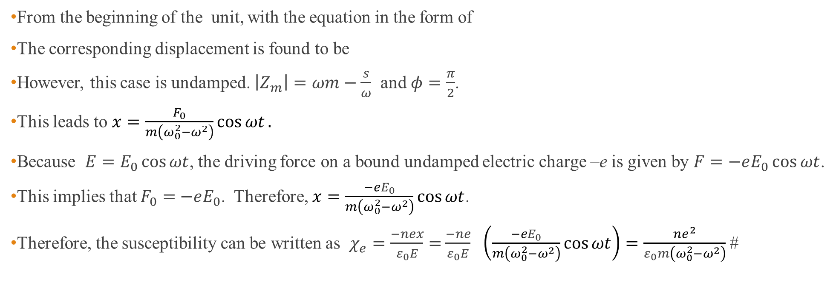
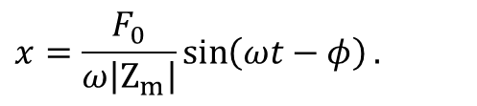
Solution
From the beginning of the unit, with the equation in the form of
The corresponding displacement is found to be
However, this case is undamped. $\left|Z_{m}\right|=ωm−\frac{s}{ω}$ and $φ=\frac{π}{2}$.
This leads to $x=\frac{F_{0}}{m\left(ω_{0}^{2}−ω^{2}\right)}\cos{ωt}.$
Because $E=E_{0}\cos{ωt}$, the driving force on a bound undamped electric charge –e is given by $F=−eE_{0}\cos{ωt}$.
This implies that $F_{0}=$ $−eE_{0}$. Therefore, $x=\frac{−eE_{0}}{m\left(ω_{0}^{2}−ω^{2}\right)}\cos{ωt}$.
Therefore, the susceptibility can be written as $χ_{e}=\frac{−nex}{ε_{0}E}=$ $\frac{−ne}{ε_{0}E}$ $\left(\frac{−eE_{0}}{m\left(ω_{0}^{2}−ω^{2}\right)}\cos{ωt}\right)=\frac{ne^{2}}{ε_{0}m\left(ω_{0}^{2}−ω^{2}\right)}$ #
$$m\ddot{x}+r\dot{x}+sx=F_{0}\cos{ω}t.$$
$$x=\frac{F_{0}}{ω\left|Z_{m}\right|}\sin\left(ωt−φ\right).$$

Slide 32
Power supplied to an oscillator by the driving force
To maintain the steady state, the average power supplied by the driving force just equals that being dissipated by the frictional force.
Dissipated power by frictional force
Average power supplied by the driving force
Notes:
The instantaneous power P supplied is equal to the product of the instantaneous driving
force and the instantaneous velocity;

Slide 33
Variation of P_{av} with ω; Absorption resonance curve
The maximum average power is achieved when cosφ = 1 and Z_{m} = r.
This corresponds to the case when ω = ω₀ and velocity is in phase with applied force.
The sharpness of the peak at resonance is determined by the value of damping constant r.
The curve is known as the absorption curve of the oscillator

Slide 34
The Q-value in terms of the resonance absorption bandwidth
The absorption curve in the previous slide can be used to defined the Q-value as follows
where ω₁ and ω₂ are frequencies at which the power supplied
And

Slide 35
The Q-Value as an amplification factor
Note that for high values of Q, the damping constant r is small.
The displacement amplitude curve can be shown in terms of the quality factor Q of the system.

Slide 36
Vibration isolation

Slide 37
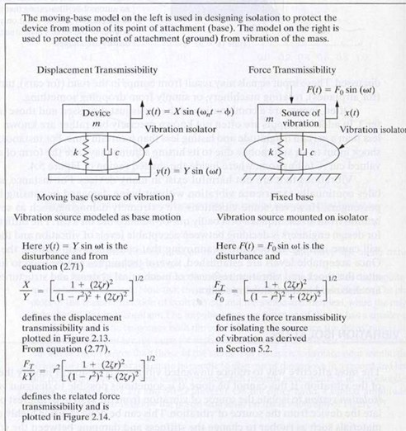
Vibration isolation
Generally, the vibration isolation can be divided into to two basic types ; i.e.,
(1) displacement isolation and (2) force isolation.
The moving-base model on the left is used in designing isolation to protect the device from motion of its point of attachment (base).
The model on the right is used to protect the point of attachment (ground) from vibration of the mass.
http://slideplayer.com/slide/8032841/

Slide 38
Problem on displacement vibration insulation
y = vertical displacement of the base about its rest position.
x = vertical vibration of the floor about its equilibrium position
Requirement :Protect sensitive objects (i.e. heavy base) from vibrating floors and foundations.
Target : The ratio y/A is kept to a minimum.
This ratio is known as transmissibility.
Notes:
The idea is simple: Protect sensitive objects from vibrating floors and foundations. So is the basic vibration-isolation system model,
The spring resists the movement of the vibration because it exerts an opposing force proportional to its displacement.
The damper consists of a piston moving through a viscous fluid, or a conductor moving in a magnetic field, and it removes kinetic energy and dissipate it as heat.

Slide 39
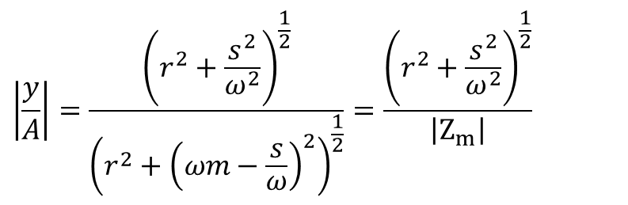
Problem on displacement vibration insulation (cont.)
Equation of motion
Suppose y > x;
Suppose
Determine the derivatives of y and x and substitute in the equation of motion.
This ends up in terms of the magnitude ratio as follows,
$$\left|\frac{y}{A}\right|=\frac{{\left(r^{2}+\frac{s^{2}}{ω^{2}}\right)}^{\frac{1}{2}}}{{\left(r^{2}+{\left(ωm−\frac{s}{ω}\right)}^{2}\right)}^{\frac{1}{2}}}=\frac{{\left(r^{2}+\frac{s^{2}}{ω^{2}}\right)}^{\frac{1}{2}}}{\left|Z_{m}\right|}$$
Notes:
y-x เป็นระยะกระจัดสัมพัทธ์ ของตัวถ่ายทอดการสั่นซึ่งประกอบด้วย spring และ damper
dy/dt – dx/dt เป็นความเร็วสัมพัทธ์ของตัวถ่ายทอดการสั่น

Slide 40
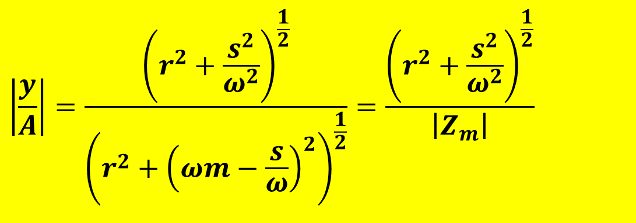
Physical meaning of the ratio |y/A|
$$\left|\frac{y}{A}\right|=\frac{{\left(r^{2}+\frac{s^{2}}{ω^{2}}\right)}^{\frac{1}{2}}}{{\left(r^{2}+{\left(ωm−\frac{s}{ω}\right)}^{2}\right)}^{\frac{1}{2}}}=\frac{{\left(r^{2}+\frac{s^{2}}{ω^{2}}\right)}^{\frac{1}{2}}}{\left|Z_{m}\right|}$$
What does it mean if the magnitude ratio is greater than 1?
Under the condition, this is found that or
Notes:
Isolation is the reduction in transmitted vibration through the storage and controlled release of vibrational energy.
The figure shows the effect of adding damping to a spring mass system. In many cases, it is impossible to add enough damping to reduce peak transmitted vibrations to acceptable levels. Therefore, the system engineer must ensure that the natural frequency of the system is sufficiently below the disturbing frequency so the transmitted vibrations are minimized.
W0 here is the natural frequency while w is the driving frequency.

Slide 41
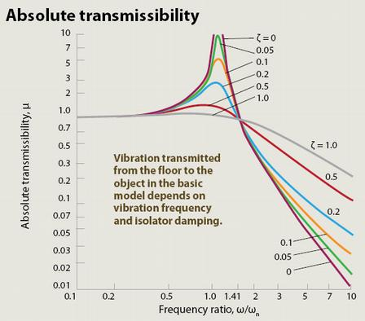
Displacement Transmissibility |y/A|
The displacement vibration isolator will generally operate at the mass controlled end of the frequency spectrum and the resonant frequency is designed to be lower than the range of frequencies likely to be met.
http://machinedesign.com/archive/shaking-vibration-models
Notes:
Isolation is the reduction in transmitted vibration through the storage and controlled release of vibrational energy.
The figure shows the effect of adding damping to a spring mass system. In many cases, it is impossible to add enough damping to reduce peak transmitted vibrations to acceptable levels. Therefore, the system engineer must ensure that the natural frequency of the system is sufficiently below the disturbing frequency so the transmitted vibrations are minimized.
ζ คือ damping ratio หรือ อัตราส่วนระหว่าง damping constant ของ system กับ critical damping constant ของระบบนั้น

Slide 42
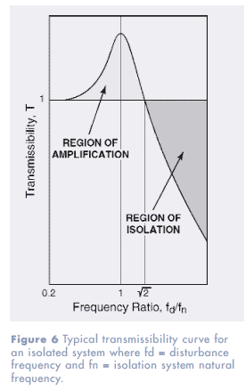
Analysis of the displacement transmissibility
From the displacement transmissibility the object vibrates less than the supporting surface of vibrating frequency if vibration frequency (region of isolation).
Lower-stiffness vibration isolators decrease the natural frequency ω₀ and transmit less vibration to the object for almost driving frequencies.
The increasing isolator damping reduces an object’s vibration amplitude at by decresing isolation at (region of amplification).
http://www.novibration.com/isoselectguide.htm
Notes:
Because ω₀ ^2 = s/m, s↓ then ω₀ ↓

Slide 43
Displacement transmissibility in terms of damping ratio ζ
By definition, the damping ratio ζ is given as the ratio of the damping factor to the critical damping factor,
This leads to
Therefore, the transmissibility in terms of ζ is written as
Notes:
Transmissibility is another concept that summarizes particular behaviors of a mass, spring, damper system. It is the steady state amplitude ratio of output to input for a given frequency ratioand damping ratio.

Slide 44
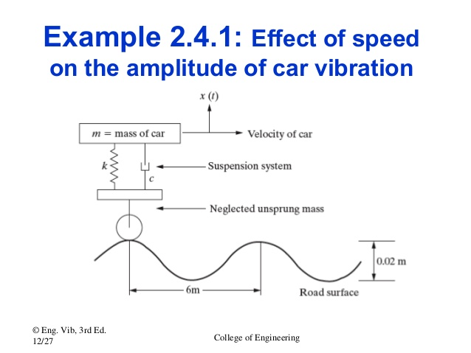
Problem : Effect of speed on the amplitude of car vibration
y(t)
Given
(1) car speed = 20 km/hr
(2) car mass = 1007 kg
(3) stiffness s = 4 x 10⁴ N/m
(4) damping constant r = 2000 Ns/m
Determine the amplitude response of the car to the vibrating road surface by considering the surface disturbance in the form of a sinusoidal input.
20 km/hr
s
r
http://www.slideshare.net/SondiponAdhikari/base-excitation-of-dynamic-systems
Notes:
Damping constant ค่าคงตัวของการหน่วง

Slide 45
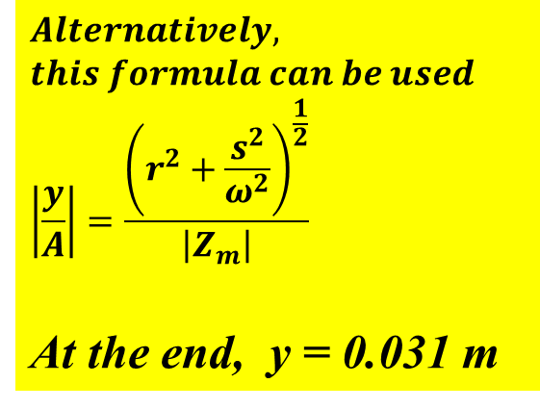
$$Alternatively,$$
$$this formula can be used$$
$$\left|\frac{y}{A}\right|=\frac{{\left(r^{2}+\frac{s^{2}}{ω^{2}}\right)}^{\frac{1}{2}}}{\left|Z_{m}\right|}$$
At the end, y = 0.031 m

Slide 46
Force vibration isolation
The vibration source is mounted on isolator composed of a spring with stiffness s and a damper with damping constant r .
The mass is disturbed by a force F(t).
What is the force transmissibility for isolating the source of vibration?
s
r
http://slideplayer.com/slide/8032841/

Slide 47
Force vibration isolation (cont.)
Equation of motion of mass m is given by
The solution as the displacement is written as
This can be written in terms of ζ, ω and ω₀ as

Slide 48
Force vibration isolation (cont.)
The response of the supporting base is due to the force combination of spring with stiffness s and damper with damping constant r .
By substituting x from the previous slide and determine the force transmissibility,
A = vibrating amplitude of the base

Slide 49
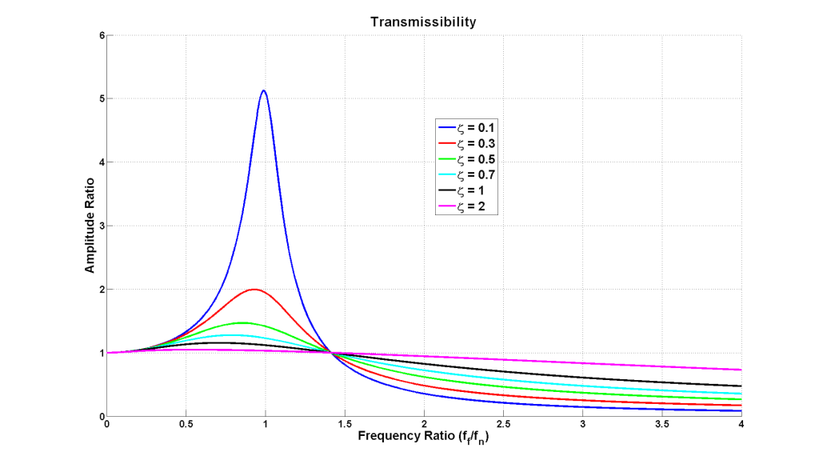
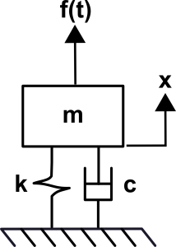
Force transmissibility curve
http://www.kaztechnologies.com/faq/
Notes:
What is transmissibility?
Transmissibility is another concept that summarizes particular behaviors of a mass, spring, damper system. It is the steady state amplitude ratio of output to input for a given frequency ratioand damping ratio. This amplitude ratio can be expressed in whatever units are of interest and most often will used as a measure of force transmitted or displacement transmitted. Transmissibility is a key concept to vibration isolation. One example of using this concept with respect to force is evaluating how a vibrating piece of equipment transmits force to the structure of a building and how this can be manipulated and reduced. A second example that would be concerned with transmitted displacement would be isolating sensitive equipment from a vibrating environment. Both of these concepts can also be extended to cars and race cars. The transmissibility plot below shows how amplitude ratio behaves as a function of frequency ratio for variousdamping ratios

Slide 50
Homework #3

Slide 51
Homework #3 (cont.)
2.

